Slide 1
CAMPUS LOST & FOUND MATCHER
Data Structures & Algorithms Project
Git Repository - https://github.com/ekashastri/Lost-Found-Matcher-DSA-Project-/upload/main
Singly Linked List
Dynamic record storage
Hash Table
Fast ID lookup
Searching
ID + text-field search
Matching + Files
Rule-based matching + persistence
Made by :-
Eka Shastri
Anandi Bardia
Rehanshi Kinge
Campus Lost & Found Matcher | DSA Project | 1

Slide 2
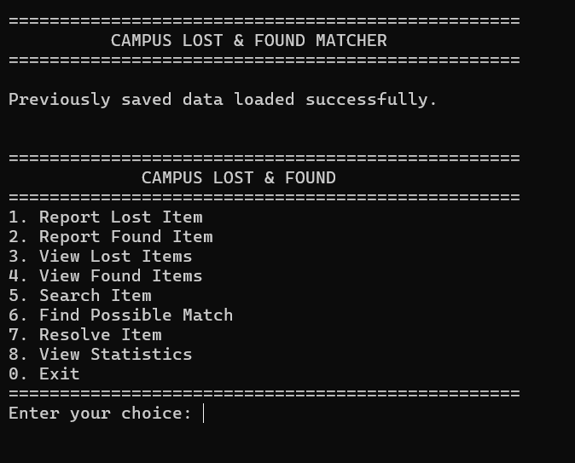
Starting Program Output
Initial screen shown when the Campus Lost & Found Matcher starts
Main menu options:
1. Report Lost Item
2. Report Found Item
3. View Lost Items
4. View Found Items
5. Search Item
6. Find Possible Match
7. Resolve Item
8. View Statistics
0. Exit

Slide 3
1. Problem Statement & Objective
Campus lost-and-found records are difficult to manage when they are stored manually.
The system maintains two categories of records: Lost Items and Found Items.
Users can add, view and search records using multiple attributes.
The program compares lost and found records to identify possible matches.
Text files preserve the records after the program closes.
Campus Lost & Found Matcher | DSA Project | 2

Slide 4
2. Overall Architecture
How the components communicate
User
Input / Menu
main()
Controls program
Linked Lists
Stores Item nodes
Hash Table
Indexes IDs
Search
Finds records
Matching
Compares records
TXT Files
lost_items.txt
found_items.txt
main() controls the menu and calls functions.
Linked lists are the primary in-memory storage.
Hashing provides an index for fast ID retrieval.
File handling loads data at startup and saves changes.
Campus Lost & Found Matcher | DSA Project | 3

Slide 5
3. The Item Structure
The record stored for every lost/found item
`struct` groups all properties of one item.
typedef struct Item
{
int id;
char name[50];
char category[30];
char color[20];
char location[50];
char date[15];
int status;
struct Item *next;
} Item;
• id → Unique ID of the item
• name → Name of the lost/found item
• category → Category of the item
• color → Color of the item
• location → Location where it was lost/found
• date → Date of the record
• status → 0 = Active, 1 = Resolved
• next → Pointer to the next Item node
Key Point:
The same Item structure is used for both Lost and Found records.
Campus Lost & Found Matcher | DSA Project | 4

Slide 6
4. Why a Singly Linked List?
1001
Wallet
1002
AirPods
1003
Bottle
NULL
End of list
The number of reports is dynamic, so a fixed-size array is not required.
Each record is allocated using malloc().
Each node stores data plus a pointer to the next node.
Two heads are maintained: lostHead and foundHead.
Current insertion at the end traverses the list, so it is O(n).
Campus Lost & Found Matcher | DSA Project | 5

Slide 7
5. Creating & Inserting a Record
Call sequence for a new lost item
main()
Step 1
reportLostItem()
Step 2
createItem()
Step 3
insertLostItem()
Step 4
insertHash()
Step 5
newItem = (Item *)malloc(sizeof(Item));
newItem->id = nextLostID++;
insertLostItem(newItem);
• malloc() dynamically creates memory for a new Item.
• createItem() takes the item details from the user.
• A unique ID is assigned to the item.
• insertLostItem() adds the node to the lost-item linked list.
• The same process is used for found items using insertFoundItem().
Campus Lost & Found Matcher | DSA Project | 6

Slide 8
6. DISPLAY & RESOLVE RECORDS
current = lostHead;
while (current != NULL)
{
displayItem(current);
current = current->next;
}
• Traverses the linked list from the first node to NULL
• displayItem() shows ID, name, category, color, location, date and status
• The same process is used for both Lost and Found records
item = hashSearch(id);
item->status = 1;
• User enters the Item ID
• The item is located using its ID
• Status changes from 0 = Active to 1 = Resolved
• The updated status is shown when the record is displayed
Campus Lost & Found Matcher | DSA Project | 6

Slide 9
7. Why a Hash Table?
Fast lookup by Item ID
int hashFunction(int id)
{
return id % TABLE_SIZE;
}
Eg: ID = 1001
1001 % 101 → bucket 91
ID = 2050
2050 % 101 → bucket 30
Hash Table
Hash Tabe uses a hash function to convert a key (like an ID or name) into an index in an array, where the corresponding value is stored.
Its types are: Separate Chaining and Open addressing (linear, quadratic and chaining)
ID lookup uses hashSearch() rather than traversing both lists.
Average hash lookup is O(1) when distribution is reasonable.
TABLE_SIZE is 101.
The hash table stores pointers to existing Item nodes.
Campus Lost & Found Matcher | DSA Project | 7

Slide 10
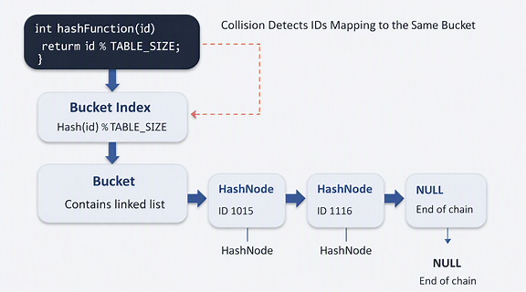
8. Collision Handling — Separate Chaining
A collision occurs when different IDs map to the same bucket.
Each bucket can contain a linked chain of HashNode objects.
HashNode stores the ID, a pointer to the Item, and next.
hashSearch() checks the bucket and follows the chain.
Campus Lost & Found Matcher | DSA Project | 8

Slide 11
9. Searching
Different searches serve different purposes
ID Search
Hash Search
Average O(1)
Name / Category / Location
Linked-list traversal
O(n)
Case-insensitive
User can search without matching letter case exactly.
item = hashSearch(id);
if (item != NULL)
displayItem(item);
else
printf("Item not found.");
Numeric IDs are directly indexed through hashing.
Text fields are searched sequentially through the lost and found lists.
Campus Lost & Found Matcher | DSA Project | 9

Slide 12
10. Matching Algorithm
Rule-based scoring — not AI
Name
40 points
Category
20 points
Color
15 points
Location
25 points
Date
0 points
int calculateMatchScore(Item *lost, Item *found)
{
int score = 0;
if (stringEqualIgnoreCase(lost->name, found->name))
score += 40;
if (stringEqualIgnoreCase(lost->category, found->category))
score += 20;
...
return score;
}
Maximum score = 100.
80–100: Strong Match | 50–79: Possible Match | 30–49: Weak Match.
Campus Lost & Found Matcher | DSA Project | 10

Slide 13
11. Matching Call Flow
Lost ID
hashSearch()
Lost Item
foundHead
calculateMatchScore()
Score ≥ 30?
First, the lost record is located by ID.
Then every active found record is compared.
Each comparison produces a weighted score.
Only records meeting the display threshold are shown.
The scan of found records is O(m), where m is the number of found records.
Campus Lost & Found Matcher | DSA Project | 11

Slide 14
12. File Handling — Permanent Storage
Program Start
loadAllData()
TXT Files
lost_items.txt
found_items.txt
Rebuild Data
Linked Lists + Hash Table
fprintf(file, "%d|%s|%s|%s|%s|%s|%d\n",
current->id, current->name,
current->category, current->color,
current->location, current->date,
current->status);
fscanf() reconstructs Item nodes when loading.
fprintf() writes records when saving.
File handling provides persistence; it is not a DSA structure.
Campus Lost & Found Matcher | DSA Project | 12

Slide 15
13. TXT File Format
1001|Wallet|Accessories|Black|Library|15/09/2026|0
ID
1
Name
2
Category
3
Color
4
Location
5
Date
6
Status
7
Fields are separated by |.
Status 0 = Active; Status 1 = Resolved.
Lost and found records are stored in separate files.
At startup, the lines are parsed and converted back into Item nodes.
Campus Lost & Found Matcher | DSA Project | 13

Slide 16
14. Complete Program Flow
START
Initialize
Hash Table
Load TXT
Files
Build Lists
+ Hash
Display
Menu
User
Choice
Call
Function
Modify → Save
→ Continue
The program is menu-driven.
Every menu option calls a specific function.
Functions operate on the shared linked-list and hash-table structures.
Changes are saved so records survive program exit.
Campus Lost & Found Matcher | DSA Project | 14

Slide 17
15. Coding Division
Rehanshi
Data Management
Item struct
Linked Lists
Create / Insert / Display / Resolve
1. createItem()
2. insertLostItem()
3. insertFoundItem()
4. displayItem()
5. displayLostItems()
6. displayFoundItems()
7. reportLostItem()
8. reportFoundItem()
Anandi
Search & Hashing
Hash Table
ID Search
Name / Category / Location Search
1. removeNewline()
2. toLowerCase()
3. stringEqualIgnoreCase()
4. readInteger()
5. hashFunction()
6. initializeHashTable()
7. insertHash()
8. hashSearch()
9. searchByName()
10. searchByCategory()
11. searchByLocation()
Eka
Matching & Persistence
Matching Score
File Handling
Statistics + main()
1. calculateMatchScore()
2. displayMatchStatus()
3. findMatches()
4. resolveItem()
5. showStatistics()
6. saveToFile()
7. saveAllData()
8. loadFromFile()
9. loadAllData()
10. freeList()
11. freeHashTable()
12. displayMenu()
13. main()
Campus Lost & Found Matcher | DSA Project | 15

Slide 18
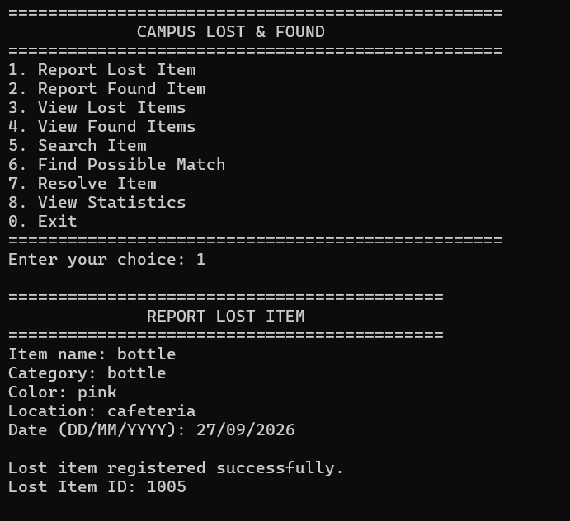
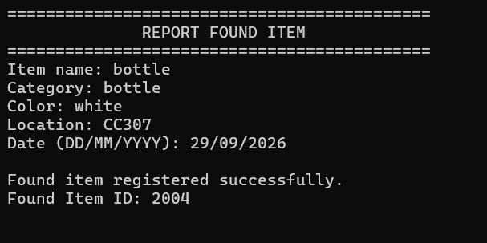
17. Algorithm & Pseudocode — Report Lost / Found Item
ALGORITHM: Input details → create Item → assign ID → insert in linked list → insert in hash table → save.
PSEUDOCODE
BEGIN
1. Read item name, category, color, location and date.
2. Allocate memory for a new Item.
3. Set status = 0 and next = NULL.
4. If Lost: assign nextLostID and increment it.
5. If Found: assign nextFoundID and increment it.
6. Insert the Item at the end of the correct linked list.
7. Insert the Item pointer into the hash table.
8. Display the generated Item ID.
END

Slide 19
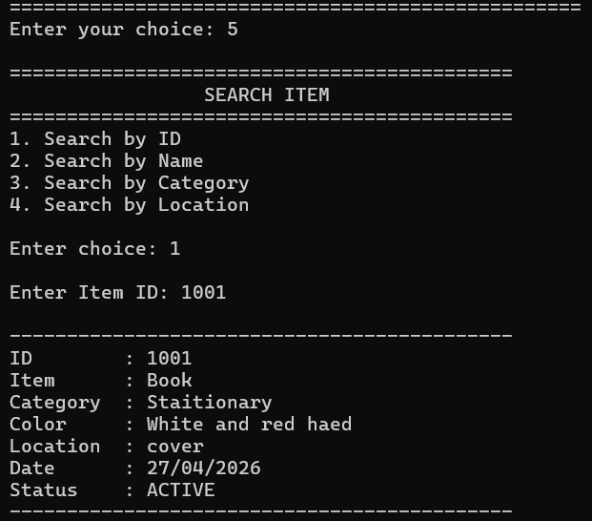
18. Algorithm & Pseudocode — Search Item
ALGORITHM: Choose ID / Name / Category / Location → use hash search or linked-list traversal → display result.
PSEUDOCODE
BEGIN
1. Display four search choices.
2. Read the user's choice.
3. If ID:
• Compute index = ID % TABLE_SIZE.
• Traverse the bucket chain.
• Return the matching Item pointer.
4. If Name, Category or Location:
• Traverse lost list and found list.
• Compare using stringEqualIgnoreCase().
• Display every matching record.
5. If no record is found, display the not-found message.
END

Slide 20
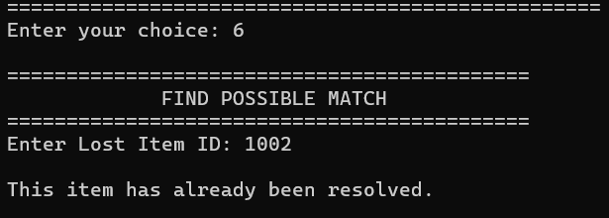
19. Algorithm & Pseudocode — Find Possible Match
ALGORITHM: Find lost record by ID → compare every ACTIVE found record → calculate 100-point score → display scores ≥ 30.
PSEUDOCODE
BEGIN
1. Check that lost and found lists are not empty.
2. Read the Lost Item ID.
3. Find the lost item using hashSearch().
4. Reject if the ID is invalid or the lost item is resolved.
5. Set current = foundHead.
6. While current != NULL:
• If current->status == 0, calculate score.
• Name match → +40
• Category match → +20
• Color match → +15
• Location match → +25
• If score >= 30, display possible match.
• Score >= 80 → STRONG MATCH.
• Score >= 50 → POSSIBLE MATCH.
• Otherwise → WEAK MATCH.
• Move to current->next.
7. If no score >= 30, display no possible matches.
END

Slide 21
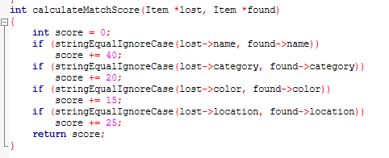
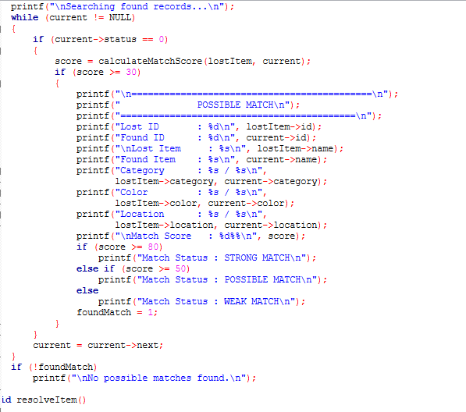
20. Matching Score — According to Current Code
CURRENT MATCHING RULES
MAXIMUM SCORE = 100
Name → 40 points
Category → 20 points
Color → 15 points
Location → 25 points
40 + 20 + 15 + 25 = 100
Display threshold:
score >= 30 → candidate is displayed
Match status:
80–100 → STRONG MATCH
50–79 → POSSIBLE MATCH
30–49 → WEAK MATCH
Date is NOT a matching parameter.

Slide 22
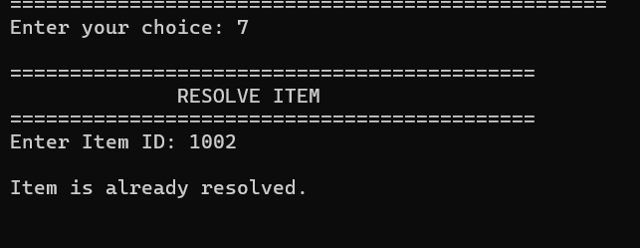
21. Algorithm & Pseudocode — Resolve Item
ALGORITHM: Read ID → locate item with hashSearch() → change status to RESOLVED → save both files.
PSEUDOCODE
BEGIN
1. Read the Item ID.
2. Call hashSearch(ID).
3. If item == NULL, display 'Item not found'.
4. If status == 1, display 'already resolved'.
5. Otherwise set item->status = 1.
6. Display the resolved message.
7. Save lost_items.txt and found_items.txt.
END

Slide 23
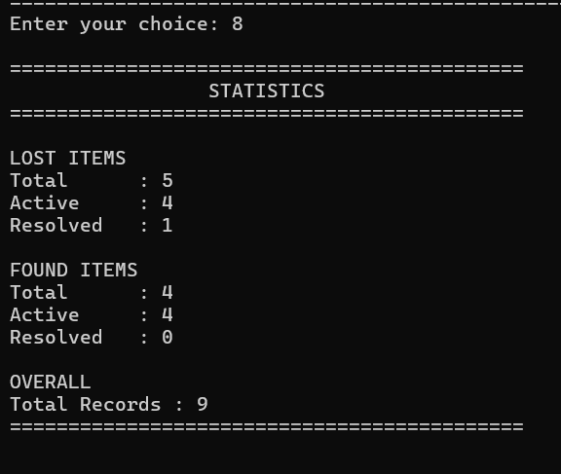
22. Algorithm & Pseudocode — Statistics
ALGORITHM: Traverse both linked lists → count total, active and resolved records → display totals.
PSEUDOCODE
BEGIN
1. Set all counters to 0.
2. Traverse lostHead.
• Increment lostTotal.
• If status = 0, increment lostActive.
• Else increment lostResolved.
3. Traverse foundHead.
• Increment foundTotal.
• If status = 0, increment foundActive.
• Else increment foundResolved.
4. Display Lost, Found and Overall totals.
END

Slide 24
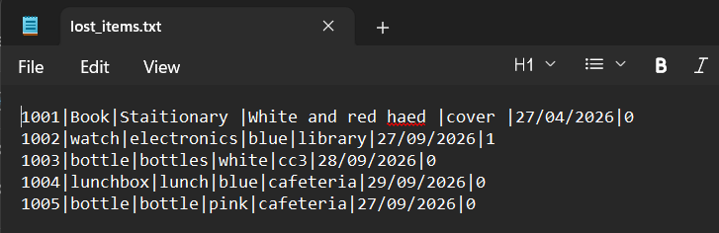
23. Algorithm & Pseudocode — File Handling
ALGORITHM: Save by traversing a list and writing records; load by reading records and rebuilding lists + hash table.
PSEUDOCODE
SAVE
1. Open file using fopen(filename, "w").
2. Traverse the linked list.
3. Write each record as:
ID|Name|Category|Color|Location|Date|Status
4. Close the file.
LOAD
1. Open file using fopen(filename, "r").
2. Read all 7 fields using fscanf().
3. Allocate a new Item.
4. Copy the loaded fields into the Item.
5. Insert into Lost/Found linked list.
6. Insert the same Item into the hash table.
7. Update the next ID counters.
8. Close the file.

Slide 25
24. Complete Program Algorithm & Flow
START
↓
Initialize all hashTable buckets to NULL
↓
loadFromFile(LOST_FILE, 0)
loadFromFile(FOUND_FILE, 1)
↓
Display main menu
↓
Read choice
↓
1 → Report Lost → Save
2 → Report Found → Save
3 → View Lost
4 → View Found
5 → Search Item
6 → Find Possible Match
7 → Resolve Item → Save
8 → View Statistics
0 → Save → Exit
↓
If choice != 0, repeat menu
↓
Free lost list, found list and hash table
↓
STOP

Slide 26
Time Complexity Analysis
Complexity of the actual operations implemented in the current C program
Operation | Data Structure / Method | Time Complexity | Reason
Insert Lost / Found Item | Singly Linked List | O(n) | Current code traverses to the last node.
Hash Insert | Hash Table + Chaining | O(1) average | Bucket index is computed directly from ID.
Search by ID | Hash Table + Chaining | O(1) average | Direct bucket access; chain traversal on collision.
Search by Name / Category / Location | Linked-list traversal | O(n) | Records are checked sequentially.
Display Lost / Found | Linked List | O(n) | Every node is traversed and displayed.
Find Possible Match | Found linked list | O(m) | Every active found record is checked; m = found records.
Statistics | Two linked-list traversals | O(n + m) | All lost and found records are counted.
Save / Load File | File + Linked List | O(n) | Each record is written/read once per file.
Free Memory | Linked Lists + Hash Nodes | O(n + m) | All allocated nodes are released.
Important: Hash search is O(1) on average but can become O(n) in the worst case if many IDs collide into one bucket. Matching scans the found list, so its complexity is O(m).

